Slide 1
INTRODUCING AGILE
Prepared by Diane Goy
Prepared for Leadership Team
OCTOBER 2024

Slide 2
AGENDA
What is Agile?
Agile Roles
Agile Phases
What is Waterfall?
Agile vs Waterfall
Conclusion

Slide 3
What is agile?

Slide 4
Agile at a glance
An iterative and incremental approach to software development that emphasizes flexibility, collaboration, and customer feedback throughout the software development lifecycle (Spundak et al., 2020).
Agile values:
Individuals and interactions over processes and tools
Working software over comprehensive documentation
Customer collaboration over contract negotiation
Responding to change over following a project plan

Slide 5
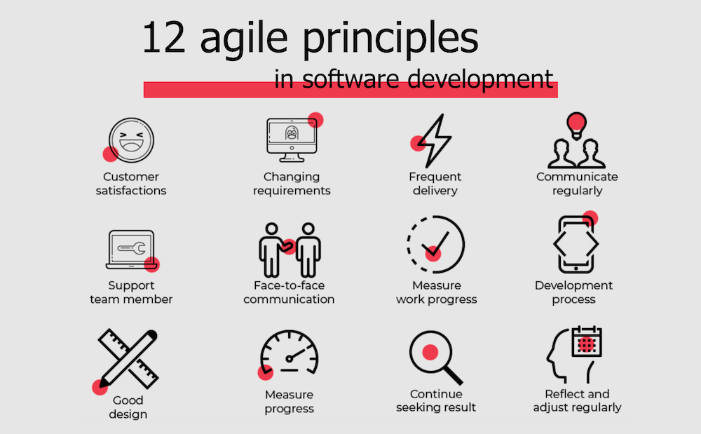
(LeanWisdom, 2022)

Slide 6
AGILE ROLES
Scrum Master
Product Owner
Developer
Tester
Client

Slide 7
Agile roles
ROLE | DOMAIN | KEY IMPACTS
Scrum Master | Facilitate Scrum process Remove impediments Ensure adherence to Agile principles | Facilitates collaboration & communication while upholding the Scrum framework effectively to meet project goals.
Product Owner | Define product vision Manage product backlog Ensure delivery of value | Liaise between stakeholders & the agile team; ensure the product vision is well defined, prioritized, & effectively executed.
Developer (Team Member) | Design & build the product increment Collaborate with team to deliver high-quality work | The craftsperson who incrementally transforms the product’s vision, backlog & user stories into tangible, high-quality software.
Tester | Validate product’s functionality and quality Create and execute test cases Ensure acceptance criteria is met | Ensures the quality & reliability of the product to meet user needs by providing timely feedback, testing exercises, and bug identification/fixes.
Each team member on an agile team plays an integral role that supports the iterative development process and successful delivery of high-quality products (Kulsrud, 2020).

Slide 8
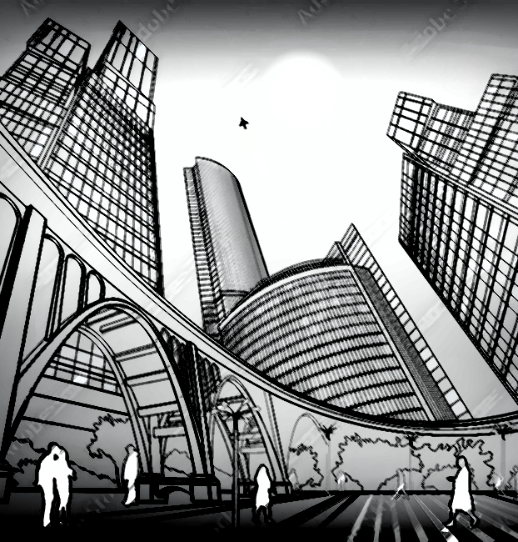
Agile infrastructure

Slide 9
ceremonies
artifacts
Daily Scrum
Sprint Planning
Sprint Review
Sprint Retrospective
Product Backlog
Sprint Backlog

Slide 10
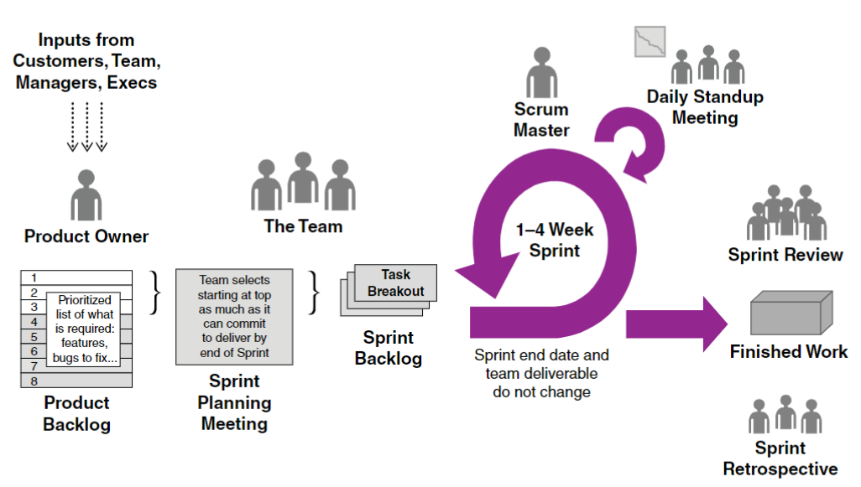
AGILE Framework
(Cobb, 2015)

Slide 11
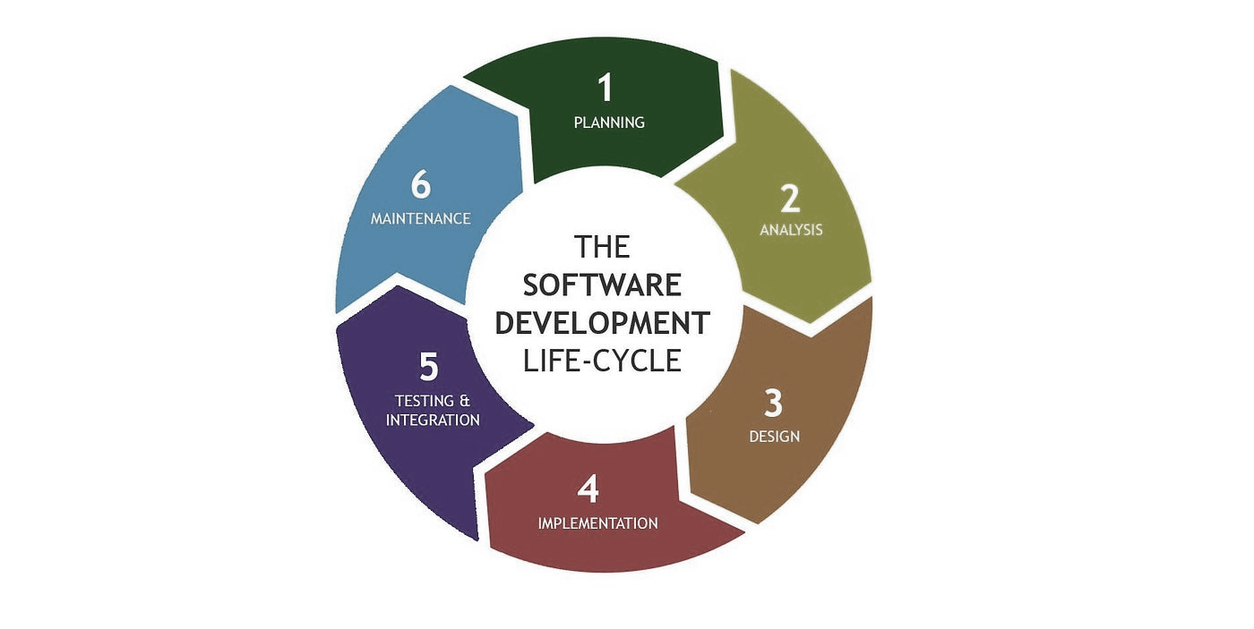
SDLC phases for agile
A project run using an agile approach would not move through linear phases from start to finish (Rigby, Elk, & Berez, 2020), instead it would move through various iterations of the following cycle:
Requirements are gathered via feedback & stakeholder/customer insights
The product backlog is refined, revised, prioritized
Sprint planning informs the next sprint and the sprint backlog
The sprint runs from 1-4 weeks with daily standups – design, develop, test!
Work is reviewed via sprint review and retrospective
Lather, rinse, repeat!

Slide 12
What is waterfall?

Slide 13
waterfall at a glance
A linear and sequential approach to software development where each phase must be completed before moving on to the next, emphasizing thorough planning and documentation to guide the project from conception to delivery
Some key waterfall aspects
Linear phases
Extensive documentation
Clear milestones
Limited flexibility
Sequential dependency

Slide 14
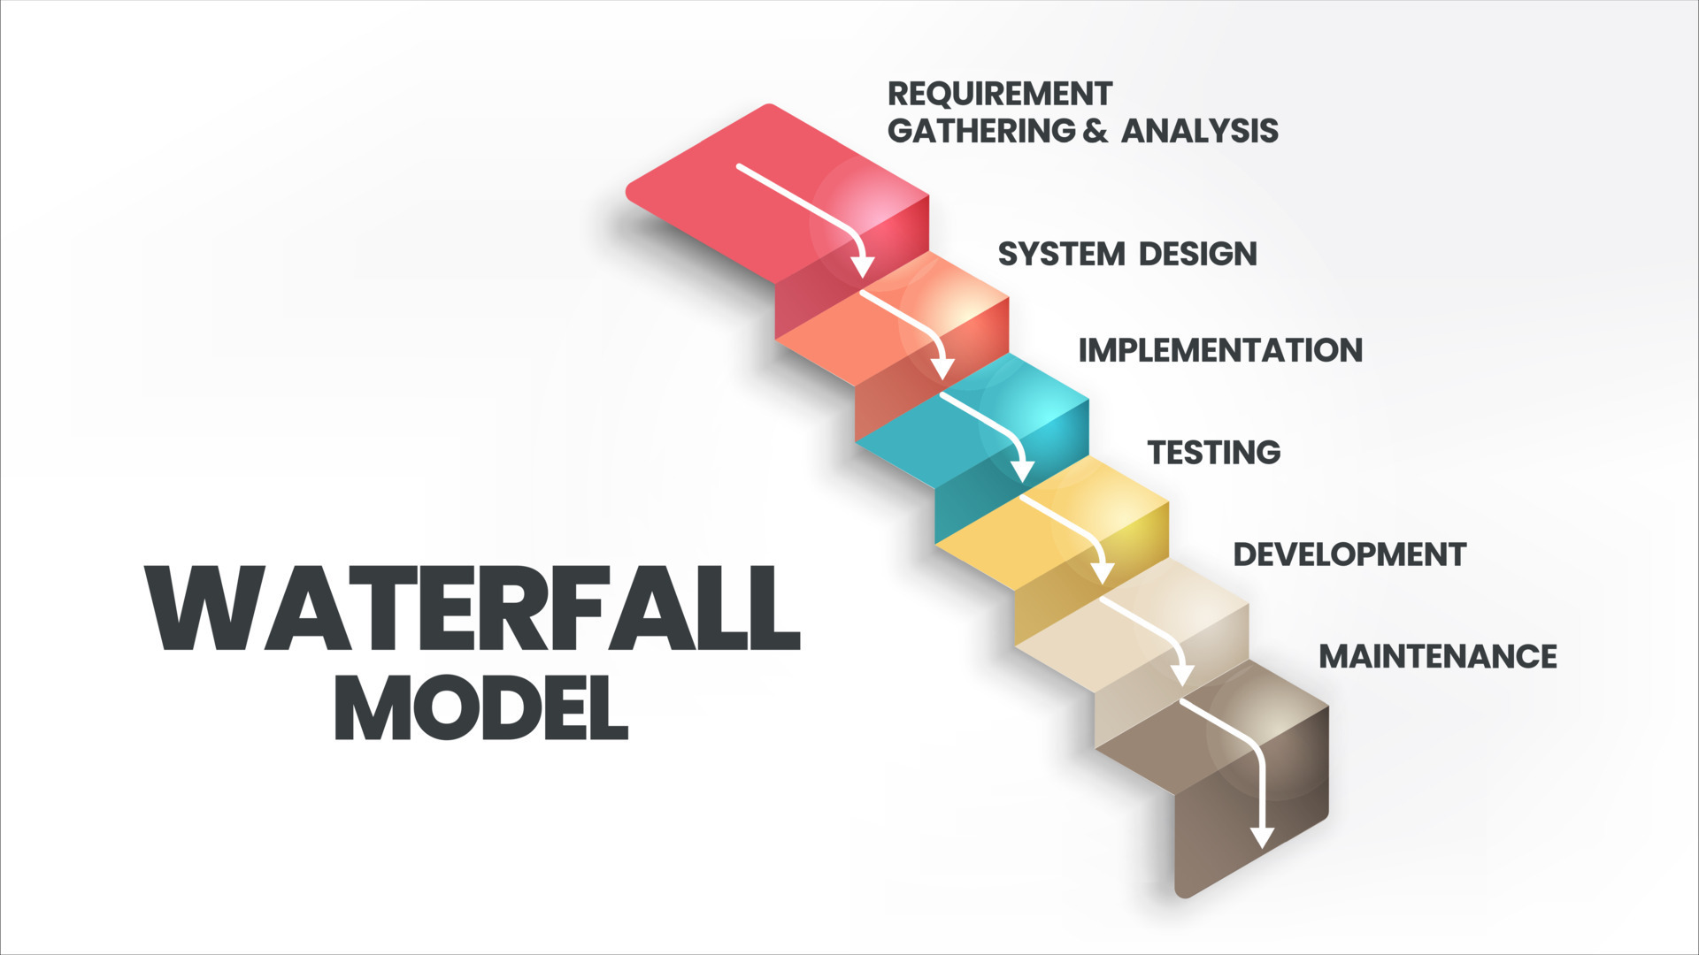
Waterfall framework
(BAP Software, n.d.)

Slide 15
Case study
WATERFALL APPROACH | AGILE APPROACH
All requirements are gathered at the start of the project, excluding the then-unknown change request The team moves on to the design phase The team moves on to the development phase When the new request arises, a formal change request process is initiated The team must revisit the design and requirements phases to incorporate this new feature Development is resumed Project delivery time and budget may be impacted | Early requirements inform on the initial activities in the product backlog The first sprint is initiated and results in a completed menu feature The second sprint is initiated and results in a completed online ordering feature The new request for a delivery tracking feature arises The product backlog is updated with this new priority The next sprint includes this request Quick adjustments are made to avoid budget or timeline concerns
A restaurant requests a software development team to create a mobile application for their restaurant.
They want the app to include a menu, online ordering, and a loyalty rewards program.
Halfway through development, the restaurant decides they want to add a delivery tracking feature.

Slide 16
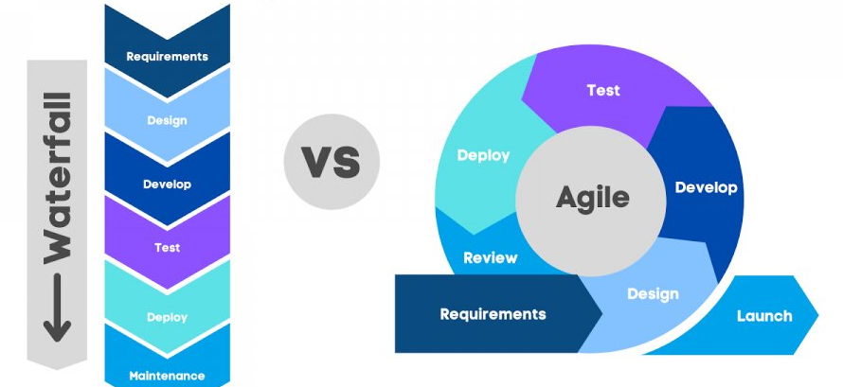
Agile vs waterfall
(Rohilla, 2024)

Slide 17


Factors to determine approach
Waterfall
Agile
Well-defined requirements, unlikely to change
Milestone only client review, low customer involvement
Strict timeline requiring predictable delivery dates
Low complexity, straightforward project goals
Testing can occur at end of development cycle
Fixed budget
Unclear or likely to evolve requirements
Heavy client involvement, high customer input
Flexible timeline that can accommodate iterative improvements
Complex with frequent reassessment of goals
Continuous testing and feedback is important and feasible
Budget adjustments can be accommodated

Slide 18
reflection
In conclusion, selecting between Agile and Waterfall methodologies for software development projects hinges on understanding the unique requirements and dynamics of each project (Kerzner, 2021).
Agile is best suited for projects characterized by evolving requirements and the need for flexibility, as it fosters continuous collaboration and rapid iteration.
In contrast, Waterfall excels in environments where project specifications are well-defined and unlikely to change, allowing for a structured and sequential approach.
Ultimately, a thorough assessment of project goals, stakeholder engagement, and the potential for change will guide teams in making an informed choice that aligns with their objectives and enhances project success.

Slide 19
REFERENCES
BAP Software. (n.d.). What is the waterfall software model? Retrieved October 2, 2024, from https://bap-software.net/en/knowledge/what-is-the-waterfall-software-models/
Cobb, C. (2015). The Project Manager’s Guide to Mastering Agile: Principles and Practices for an Adaptive Approach (p. 39). Hoboken: Wiley.
Lean Wisdom. (2022). Agile Manifesto principles. Retrieved October 2, 2024, from https://www.leanwisdom.com/blog/agile-manifesto-principles/
Kerzner, H. (2021). Innovation project management: Methods, case studies, and tools for managing innovation projects. Wiley.
Kulsrud, K. (2020). Agile teams: Structure, roles, and success factors. Journal of Software Engineering and Applications, 13(3), 155-162. https://doi.org/10.4236/jsea.2020.133010
Rigby, D. K., Elk, S., & Berez, S. (2020). Doing agile right: Transformation without chaos. Harvard Business Review Press.
Rohilla, R. (2024). Agile vs. Waterfall: Which project management method is right for you? LinkedIn. https://www.linkedin.com/pulse/agile-vs-waterfall-which-project-management-method-right-rohilla-apl1c
Spundak, M., Picek, O., & Strahonja, V. (2020). Agile project management: Complexity, iteration, and flexibility in software development. Journal of Modern Project Management, 8(2), 32-41. https://doi.org/10.19255/JMPM02204

